Slide 1


Neural Network-based Hardware Implementation for Object Detection in Autonomous Driving
Supervised by:
Dr. Khaled Salah
Dr. Mohamed Desoukky
Done by:
1-Ramy Osama
2-Ahmed Yahia
3-Zyad Mahmoud
4-Rofida Osama
5-Omar Khaled

Slide 2
Agenda:
Introduction
Problem statement
Related work
Contribution
Methodology
Implementation
Future work

Slide 3
Introduction

Slide 4
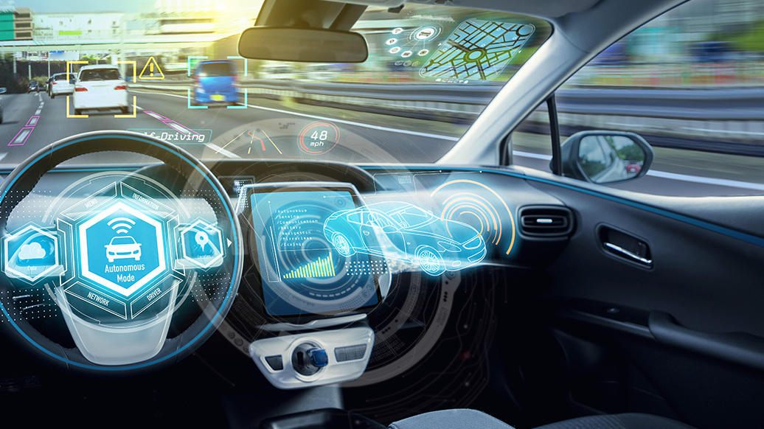
Introduction: Autonomous Car
Self-Driving car is a vehicle that is capable of sensing its environment and moving safely with little or no human input.
Accidents rate could be decreased by 90% after autonomous vehicles are in the streets.

Slide 5
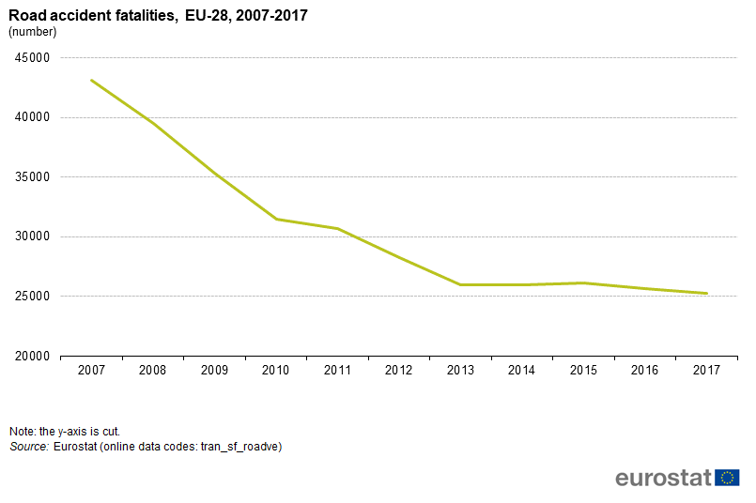

Slide 6
Introduction: Levels of automation.
Level 0 – No automation
Level 1 – Driver assistance
Level 2 – Partial automation
Level 3 – Conditional automation
Level 4 – High automation
Level 5 – Full automation

Slide 7
Introduction: Autonomous Vehicle System.
Autonomous Vehicle Software
Perception
Planning
Control
Autonomous Vehicle Hardware
Cameras
Lidar
Radar
Sensors

Slide 8
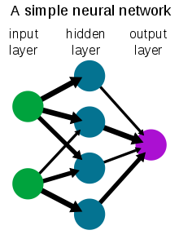
Introduction: Neural Networks
A neural network is a network or circuit of neurons, or in a modern sense, an artificial neural network, composed of artificial neurons or nodes. Thus, a neural network is either a biological neural network, made up of real biological neurons, or an artificial neural network, for solving artificial intelligence (AI) problems.

Slide 9
Problem statement

Slide 10
Why do we need neural networks in the project?
We will use a dataset of common objects we see normally in our daily life in streets to train our neural network to be able to recognise these objects in any future image that would be our input to the neural network.
Examples:
Cars
Human bodies
Cats
Dogs
Buses
Traffic posts

Slide 11
Related work

Slide 12
Going deeper with embedded fpga platform for convolutional neural network
In this paper, They go deeper with the embedded FPGA platform on accelerating CNNs and proposing a CNN accelerator design on embedded FPGA for Image-Net large-scale image classification using VGG-16 model
TensorFlow-object-detection-faster-rcnn // Shaoqing Ren, PY-faster-rcnn )2015
We got the software code using TensorFlow for the faster rcnn architecture
Edge boxes: Locating object ´ proposals from edges
The use of object proposals is an effective recent approach for increasing the computational efficiency of object detection. We figured out the method for generating object bounding box proposals using edges

Slide 13
A Platform based on HLS to Implement a Generic CNN on an FPGA,
In this paper ,it elaborates the advances of Field Programmable Gate Arrays tools allowing designs based on High-Level Synthesis, allowing a faster and an easier implementation on hardware of solutions for complex problems.This platform, developed in C language and synthetized through High-Level Synthesis, is prepared to configure a floating-point convolution neural network as a “lego”
Very Deep Convolutional Networks for Large-Scale Image
In this paper we investigate the effect of the convolutional network depth on its accuracy in the large-scale image recognition setting
https://github.com/1297rohit/VGG16-In-Keras. Coding for the vgg16 layers in keras

Slide 14
An FPGA-based accelerator implementation for deep convolutional neural networks
In this paper, an optimized FPGA-based accelerator design has been proposed claiming best performance compared with existing implementations using the same Vivado HLS tool
Implementation of deep neural networks on FPGA-CPU platform using Xilinx SDSOC
In this paper, it introduces HW/SW partitioning which will enhance time design based on high level language(C or C++) in Vivado HLS (High Level Synthesis). It also fits for more large designs than using FPGA only and faster in design time.
16-ImageNet Classification with Deep Convolutional Neural Networks
In this paper, They trained a large, deep convolutional neural network to classify the 1.2 million high-resolution images in the ImageNet

Slide 15
Contribution

Slide 16
Phases of The Project.
1st phase is to find a suitable architecture of a neural network that would be able to satisfy our constrains (delay, complexity, etc..) and implement this architecture using python machine learning modules like TensorFlow and PyTorch.
2nd phase after simulating our neural network we will get the weights resulted from the simulation (more details on that later) and use it to implement a hardware chip on a FPGA development kit.

Slide 17
Methodology

Slide 18
Methodology:
Background
How it works
Comparative study
Challenges
Dataset

Slide 19
Methodology:
Background

Slide 20
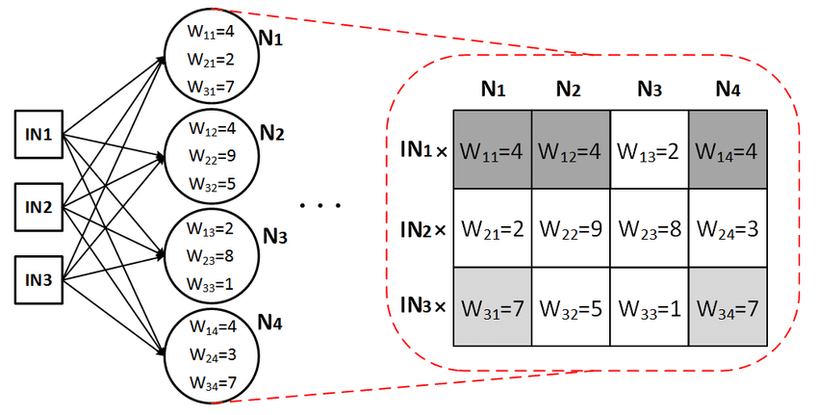
How a neuron operates ?
A neuron is just a mathematical function that takes inputs and returns outputs.

Slide 21
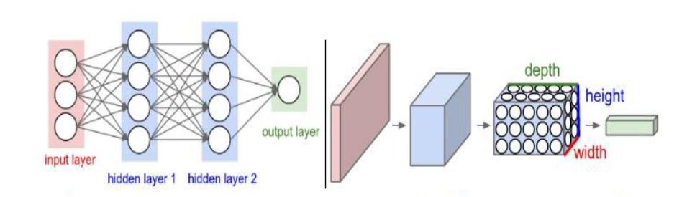
What is CNN and why using it?
Very similar to ordinary Neural Networks they are made up of neurons that have learnable weights and biases.
Output from each layer is passed to the next layer until the final classification
Also it consists of activation functions and the softmax function.

Slide 22
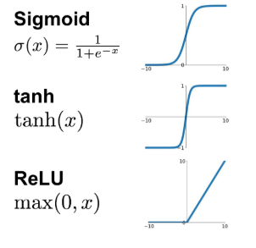
Types of activation functions.
An activation function improves the learning power of the neural network by applying some non-linearity.
Most common types include : sigmoid , RELU, and hyperbolic tangent function..
RELU is the most commonly used as it is six times faster than the other functions.

Slide 23
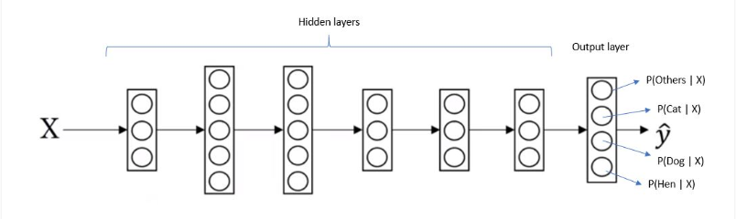
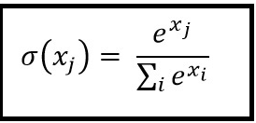
The SoftMax function.
The SoftMax function is used at the final output layer.
The main purpose is mapping the information to a probability distribution.
Classification is done based on the maximum value.

Slide 24
Layers of CNN.
Convolution
Pooling
Fully connected

Slide 25
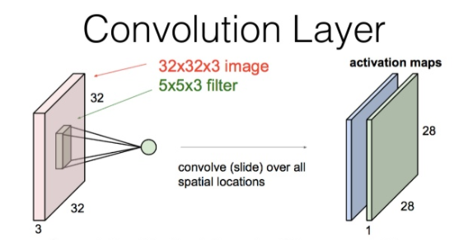
Convolution layer.
This is the first layer and one of the main building blocks of a Convolutional Neural Networks.
It uses a set of filters to extract feature maps.
Important features for training the network include: vertical and horizontal edges.

Slide 26
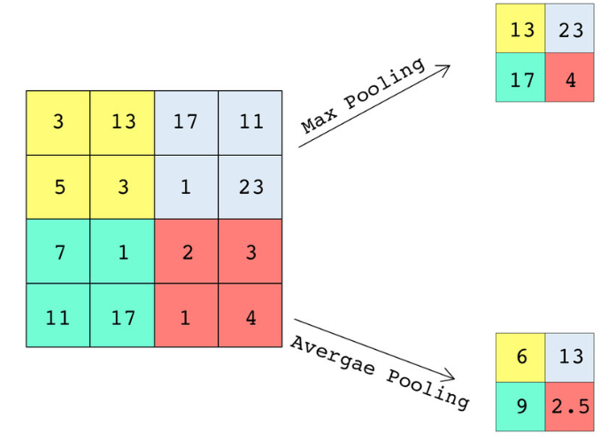
Pooling layer.
For reducing the spatial size of the representation and the number of parameters (down-sampling)
Two types including : max pool and average pool.
Important parameters include: window size and the stride.

Slide 27

Max Pooling.
It is a pooling operation that calculates the maximum value in each patch of each feature map.
Max pooling is more commonly used than the average pooling.
This has been found to work better than average pooling for computer vision tasks like image classification and reduces the computational effort.

Slide 28
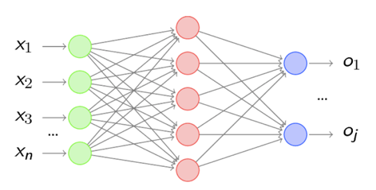
Fully connected layer.
Fully connected input layer Connect all neurons from the previous layer to the next layer
It produces at its final output a 1 dimensional vector which is then passed to the softmax function

Slide 29
Parameters that affect the Output volume size in a CNN.
These parameters include : Number of filters used , stride and padding.
Number of filters affects the depth the depth of the output equals to the number of filters used.
The stride, it affects the width and the height but does not affect the depth, as the stride increases , the size of the output decreases.
Padding is usually used if we want our output to have the same size as the input ( the size will get smaller as result of the convolution operation ).

Slide 30
Methodology:
How it works

Slide 31
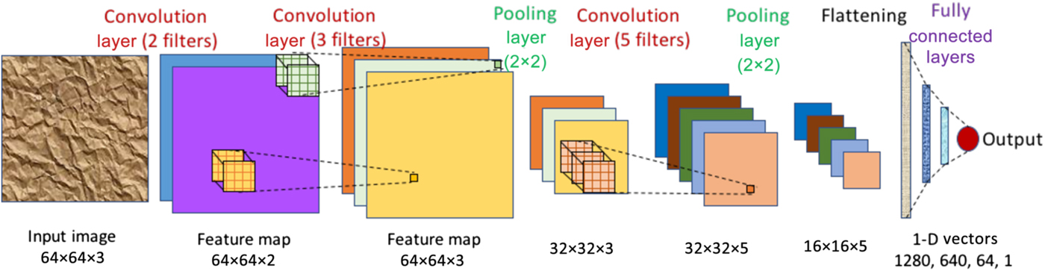

Slide 32
Methodology:
Comparative study

Slide 33
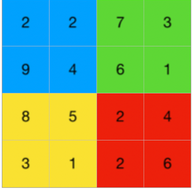
Fast RCNN.
In Fast RCNN, we feed the input image to the CNN, which in turn generates the convolutional feature maps. Using these maps, the regions of proposals are extracted.
The feature map is the output of one filter applied to the previous layer. A given filter is drawn across the entire previous layer, moved one pixel at a time.
A softmax layer is used on top of the fully connected network to output classes. Along with the softmax layer.
But still not the best.

Slide 34
FASTER R-CNN
To begin with, Faster RCNN takes the feature maps from CNN and passes them on to the Region Proposal Network. RPN uses a sliding window over these feature maps, and at each window, it generates k Anchor boxes of different shapes and sizes:
Anchor boxes are fixed sized boundary boxes that are placed throughout the image and have different shapes and sizes. For each anchor, RPN predicts two things.
The first is the probability that an anchor is an object (it does not consider which class the object belongs to)
Second is the bounding box regressor for adjusting the anchors to better fit the object.

Slide 35
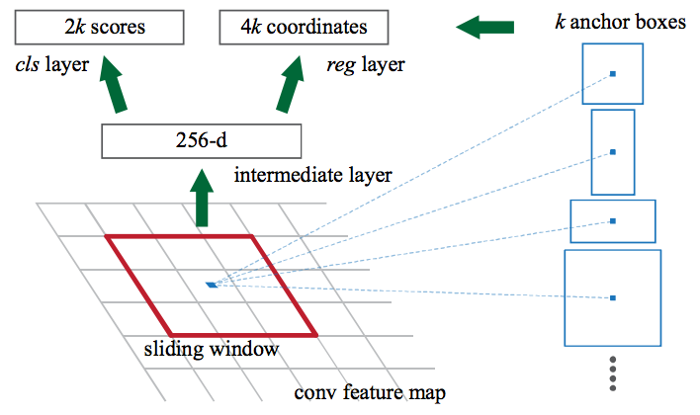
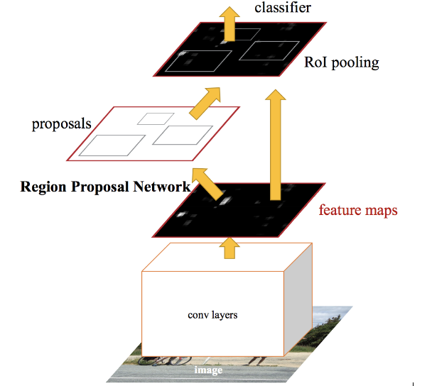

Slide 36
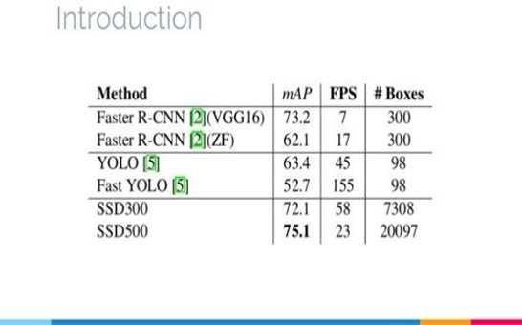
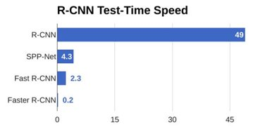
COMPARISON

Slide 37
Methodology:
Dataset

Slide 38
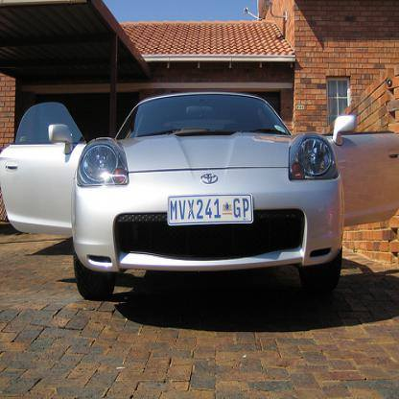
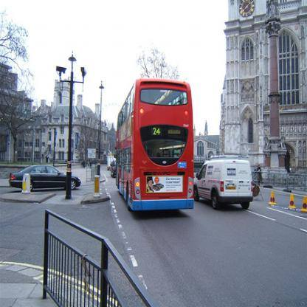
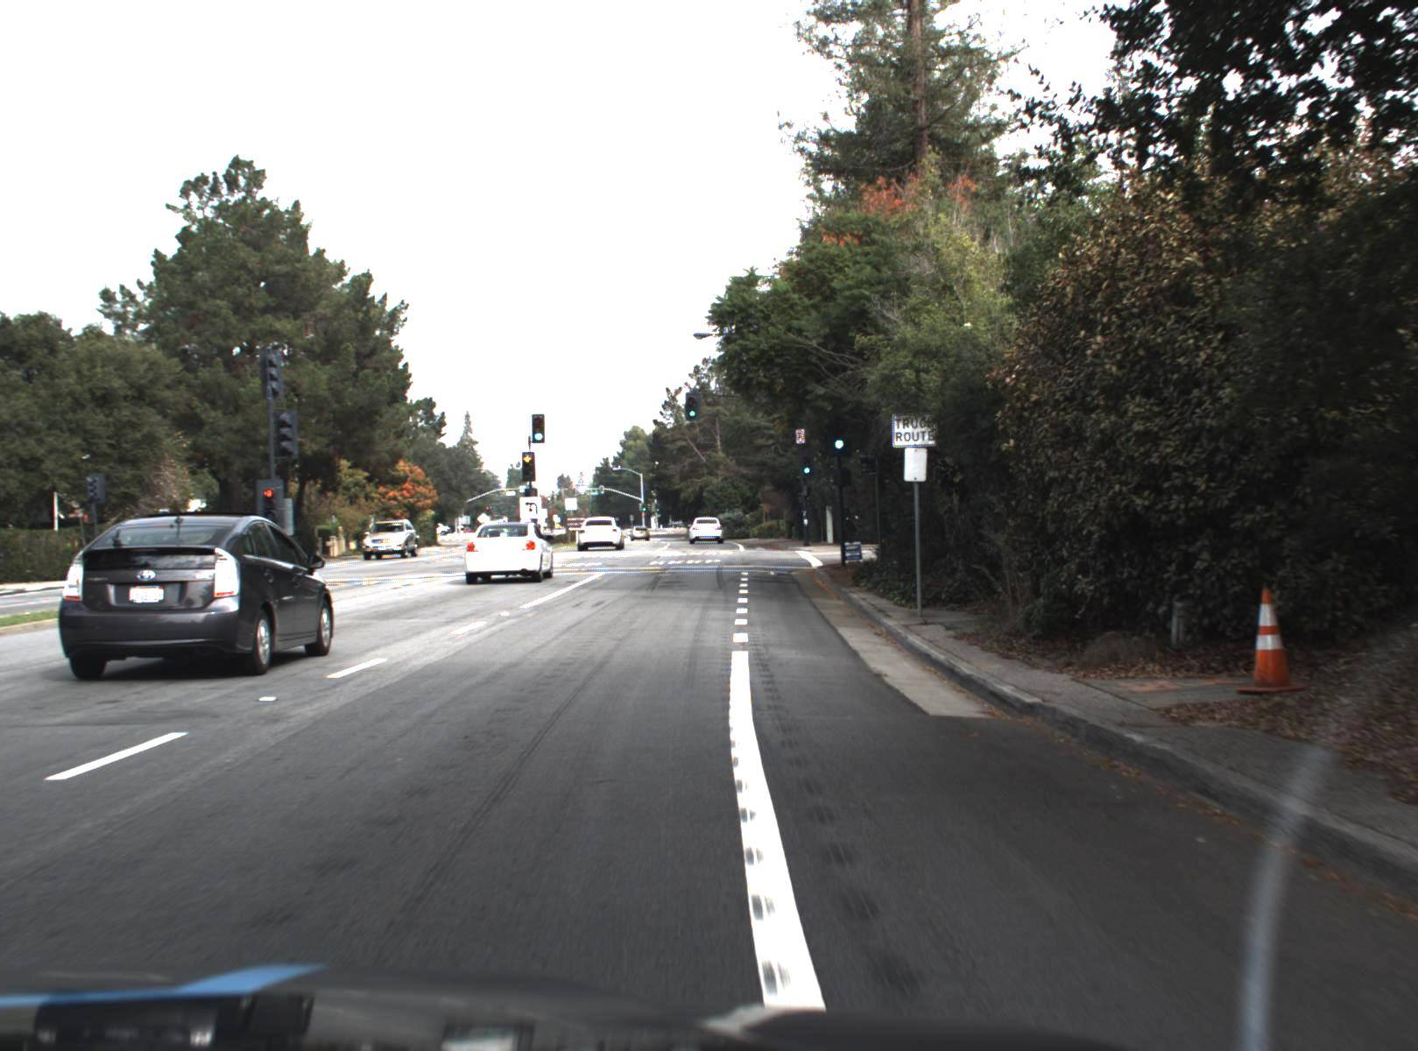
Faster-RCNN Simulation
Dataset used:
Udacity dataset
VOC dataset

Slide 39
Implementation

Slide 40
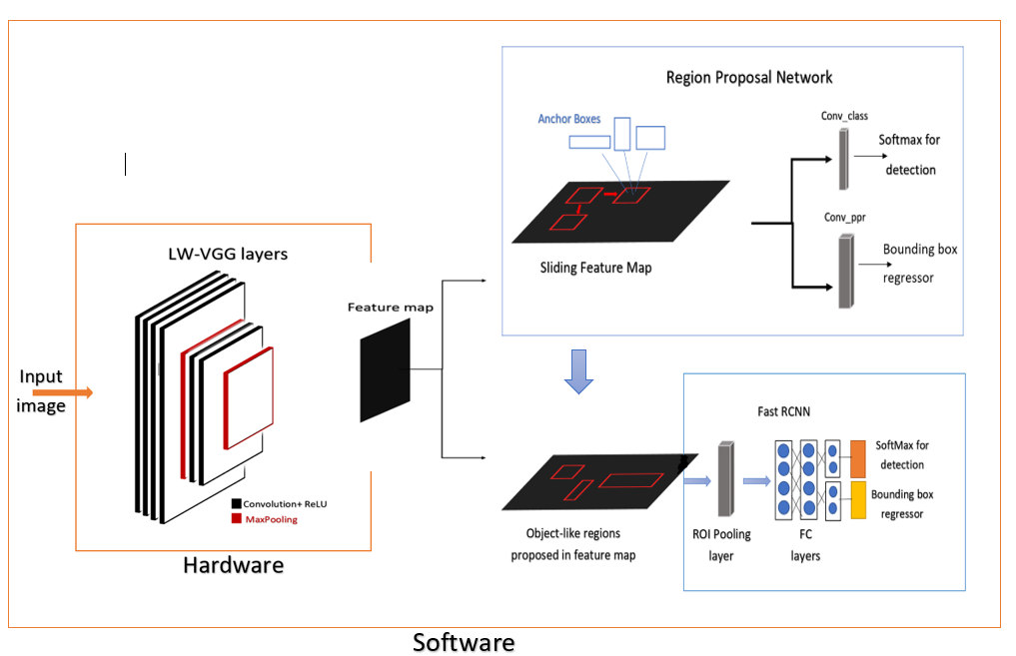
Block diagram of the project

Slide 41
Software

Slide 42
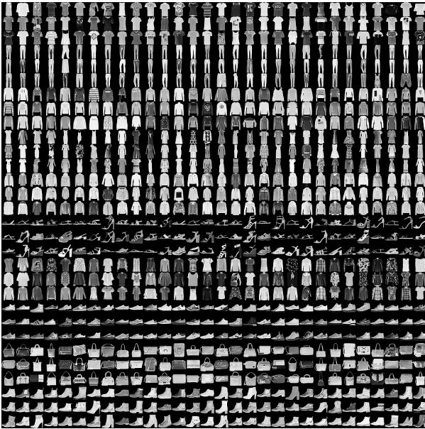
Software implementation
Objective:
Try to classify some fashion objects correctly using a neural network simulated by TensorFlow library
Used to test the concepts discussed in the literature

Slide 43
Layers used:
model = keras.Sequential([
keras.layers.Flatten(input_shape=(28, 28)), # flatten the input to be a list
# dense means a fully connected layer which is our hidden layer here relu is fast
keras.layers.Dense(128, "relu"),
keras.layers.Dense(64, "relu"),
keras.layers.Dropout(0.25),
# this is our output layer and each one of them represent what item is it ,softmax is used so that all the
# neurons in this layer add up to 1 making it a probability
keras.layers.Dense(10, "softmax")
])

Slide 44
Algorithms used
model.compile(optimizer="adam", loss="sparse_categorical_crossentropy", metrics=["accuracy"])
# this is used to train our network check what epochs is in the copybook
model.fit(train_images, train_labels, epochs=100)
# now its time to check how our network works so we will see the accuracy
test_loss, test_acc = model.evaluate(test_images, test_labels)
print("our accuracy is ", test_acc)

Slide 45
Results:
Layers | Accuracy after training | Accuracy of test data | Number of epochs | Simulation time/min | Dropout
1 Hidden layer of 128 neurons | 87% | 86% | 5 | 1.5 | 0
1 Hidden layer of 128 neurons | 90% | 88% | 10 | 3 | 0
1 Hidden layer of 128 neurons | 98% | 90% | 100 | 15 | 0.25
2 hidden layers of sizes 128 and 64 | 86% | 85% | 5 | 2 | 0
2 hidden layers of sizes 128 and 64 | 89% | 87% | 10 | 5 | 0
2 hidden layers of sizes 128 and 64 | 97% | 89.5% | 100 | 20 | 0.25

Slide 46
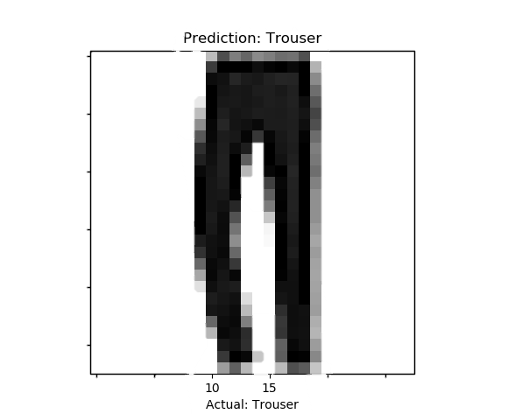
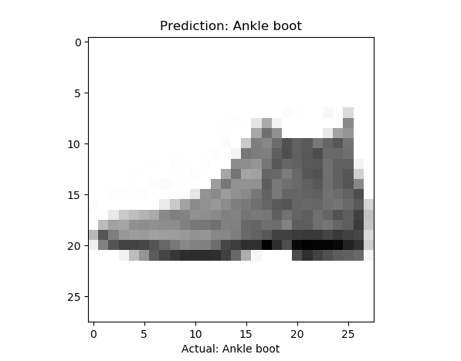
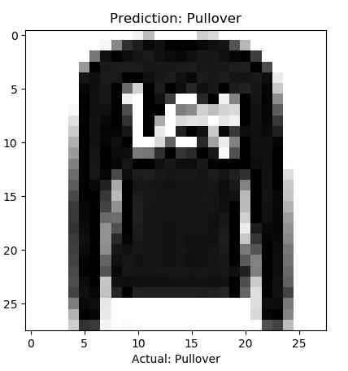
Results:

Slide 47
Faster-RCNN Simulation
Problems Faced During simulation:
Some libraries needs Linux operating system
Needs Large amounts of RAM for training
Very complex to code from scratch

Slide 48

Faster-RCNN Simulation
Solution to all of this is using Google Colabs for simulation

Slide 49
Faster-RCNN Simulation
Advantages of Google Colabs:
Fast simulation
Gives a lot of free RAM
Supports all the libraries needed in machine learning
Disadvantages of Google Colabs:
The output files are erased after the session ends
If there are input files needed for simulation, They need to be uploaded in every session

Slide 50

Faster-RCNN Simulation
Roboflow is online service to change annotation file formats to the ones you need for training.

Slide 51
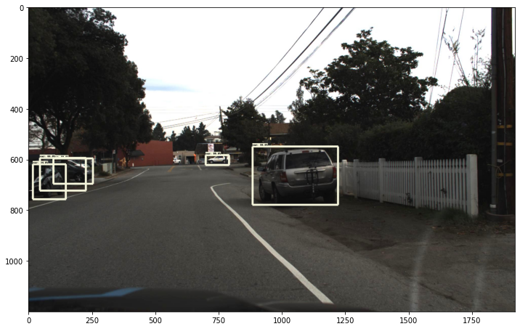
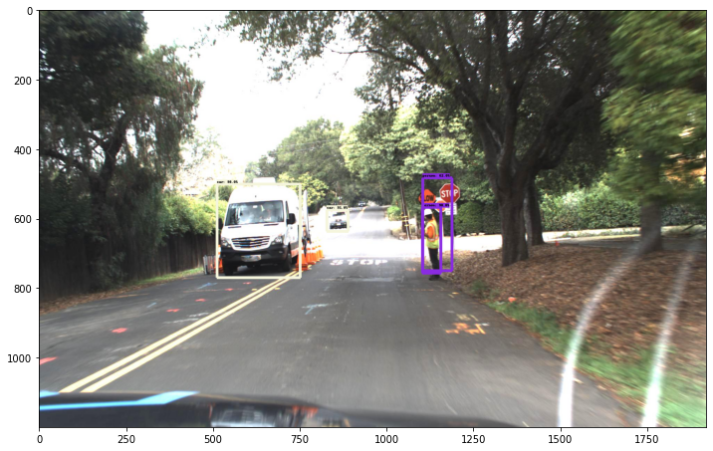
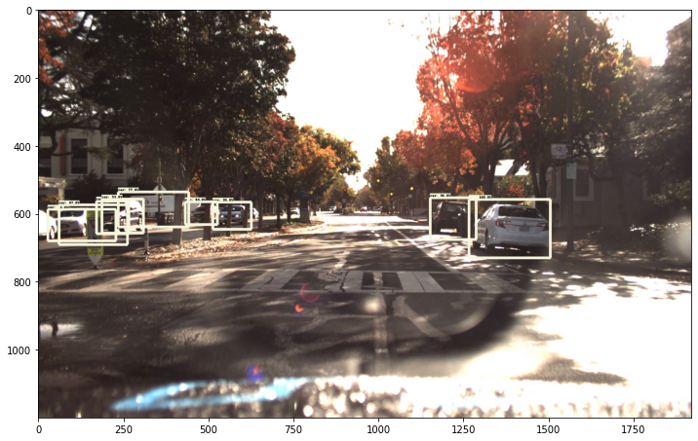
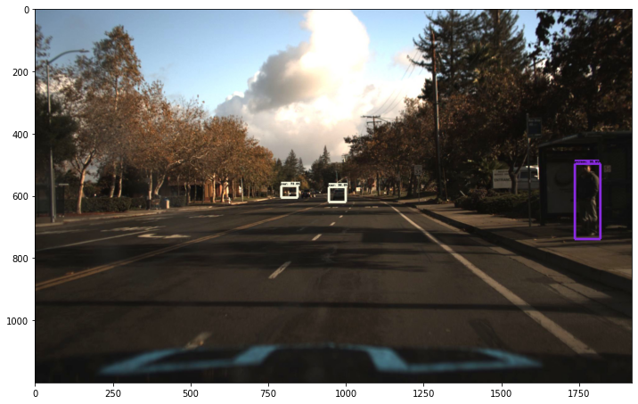
Results

Slide 52
Hardware Problems
RPN is very complex to be constructed in hardware
Limitations of memory
Needs large RAM to extract weights from the software part

Slide 53
Solution
We can construct the backbone network only in the hardware part and do a hardware/Software Co-Simulation

Slide 54
Design process
We checked the logic in the machine learning libraries in python
We write the same logic in C++ codes
We Use HLS tool to change the C++ codes to HDL codes Verilog/VHDL
PYTHON
C++
HDL
HLS

Slide 55
Extraction of weights
Backbone network of software design is vgg16, but it required nearly 46GB of RAM to extract the weights which was impossible to get even in google Colabs
So we had to design a light weight vgg16 to be compatible with the memory in hardware and we can extract weights from it with the available computational power
Layer (Type) | Output Shape | Param #
Convd2d | (None,28,28,64) | 640
Convd2d_1 | (None,28,28,64) | 36928
Max_pooling2d | (None,14,14,64) | 0
Convd2d_2 | (None,14,14,128) | 73856
Convd2d_3 | (None,14,14,128) | 147584
Max_pooling2d_1 | (None,7,7,128) | 0
Convd2d_4 | (None,7,7,256) | 295168
Convd2d_5 | (None,7,7,256) | 590080
Convd2d_6 | (None,7,7,256) | 590080
Max_pooling2d_2 | (None,4,4,256) | 0
Convd2d_7 | (None,4,4,512) | 1180160
Convd2d_8 | (None,4,4,512) | 2359808
Convd2d_9 | (None,4,4,512) | 2359808
Max_pooling2d_3 | (None,2,2,512) | 0
Convd2d_10 | (None,2,2,512) | 2359808
Convd2d_11 | (None,2,2,512) | 2359808
Convd2d_12 | (None,2,2,512) | 2359808
Max_pooling2d_4 | (None,1,1,512) | 0
Flatten | (None,512) | 0
Dense | (None,4096) | 2101248
Dense_1 | (None,4096) | 16781312
Dense_2 | (None,10) | 40970

Slide 56
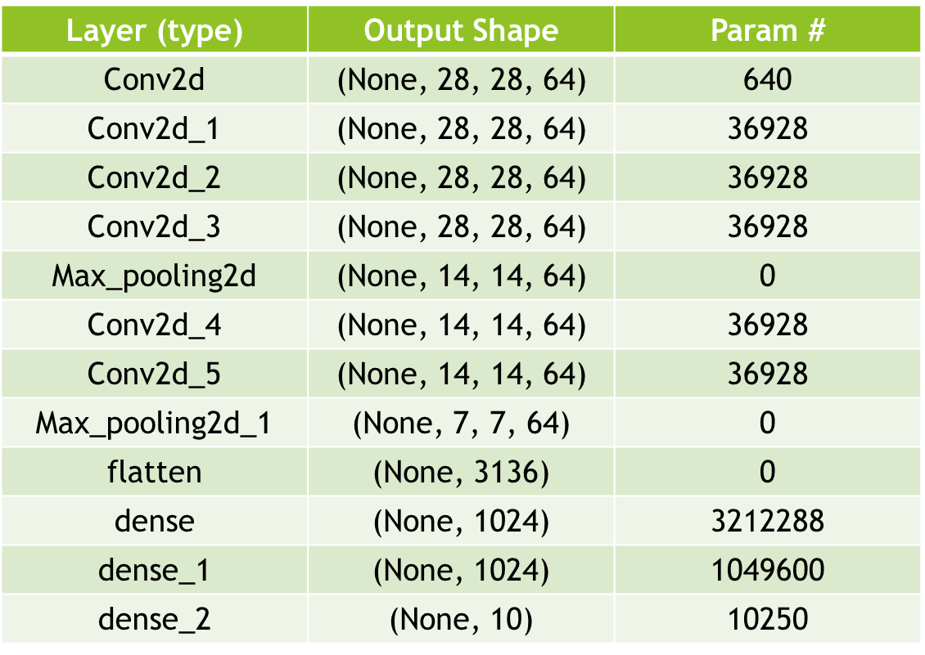
LW VGG16

Slide 57
Extraction of weights
A python script was developed to extract the weights as the normal extensions for the extracted weights in python is h5 or pb are not readable so can’t be used in hardware
Text File
✓
Script
LWVGG16
H5/Pb File

Slide 58
Changing images to readable form
Another Python script was developed to change the input images to matrix form so it can be readable in C++
Images
Software
Hardware
Images
Weights

Slide 59
Hardware

Slide 60
Methods of design
RTL
High level
Synthesis
(HLS)

Slide 61

HLS different tools
Vivado HLS by Xilinx
Catapult by Mentor
HDL coder by MathWorks
Intel High level synthesis compiler by Intel
We use :
Vivado HLS ® 2019.2

Slide 62
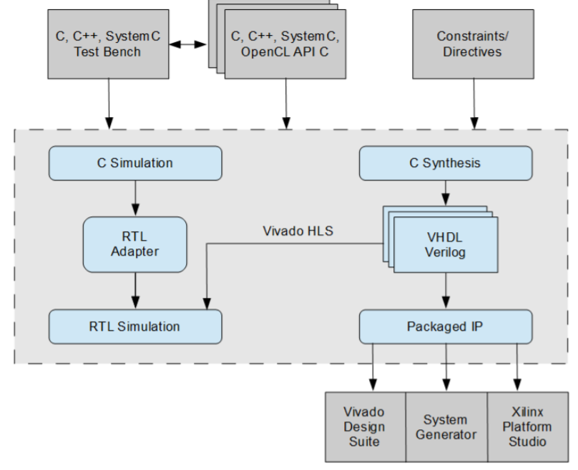
What is HLS anyway ?

Slide 63
Advantages of HLS
Designing at a higher level of abstraction = increase productivity
Debugging software is much faster than hardware
Easier to specify functions in software
Simulation of RTL takes thousands times longer than software

Slide 64
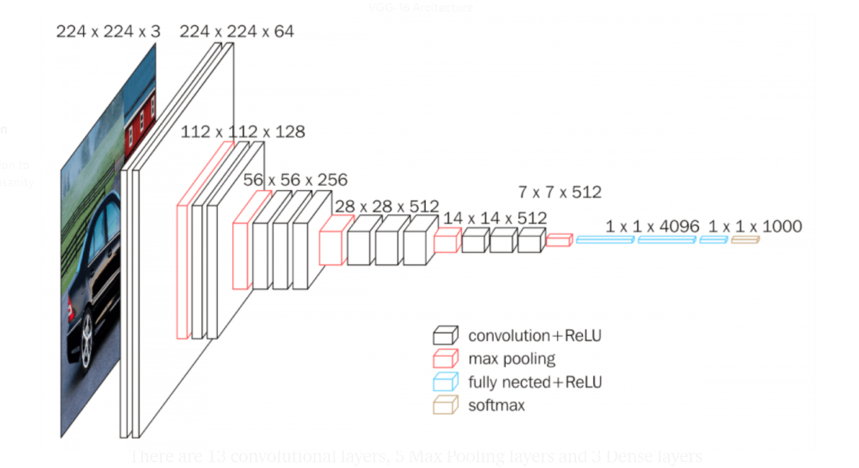
Hardware Implementation
Block diagram of layers of VGG-16
Figure 5

Slide 65
Hardware:
Convolution layer

Slide 66
Convolution Layer
Inputs: Taking the input RGB image as three-dimensional array with (channel * row * column ) and the kernels number , channels and size as four-dimension array (kernel number, kernel channel, row, column)
Outputs: The feature maps the number of them is equal to the number of filters and the size is equal to image size –kernel size +1 if no padding is used

Slide 67
Software Results_v1
Input
11 | 21 | 17 | 5 | 13
17 | 12 | 5 | 12 | 4
9 | 15 | 37 | 8 | 20
39 | 19 | 14 | 10 | 18
26 | 38 | 47 | 31 | 7
Kernel
44 | 26 | 2
33 | 39 | 46
41 | 1 | 35
Figure 15
Conv-op
4615 | 7527 | 8074
4443 | 4960 | 7363
6547 | 7192 | 5629

Slide 68
Simulation results
The simulation shows that convolution process is carried out as intend in the c++ code and below output is output of c++ testbench and the output exactly the same. Noting that the we0 (write signal in the output memory (array)is high only when the correct result signals has arrived can be specified by the clock period during project )

Slide 69
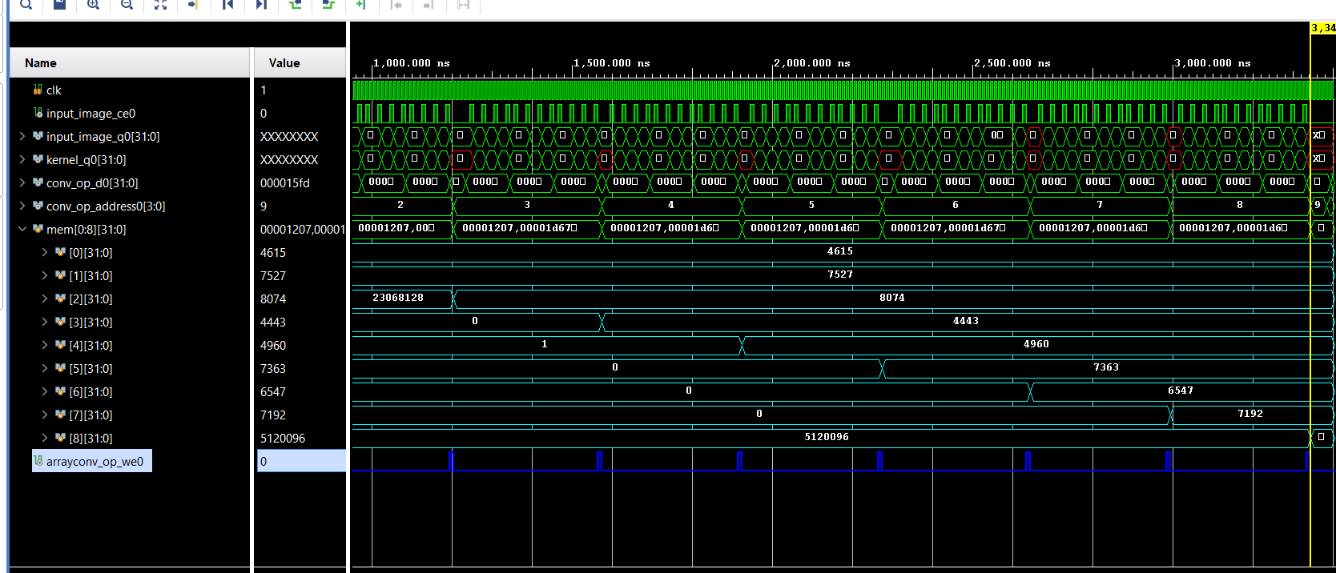

Slide 70
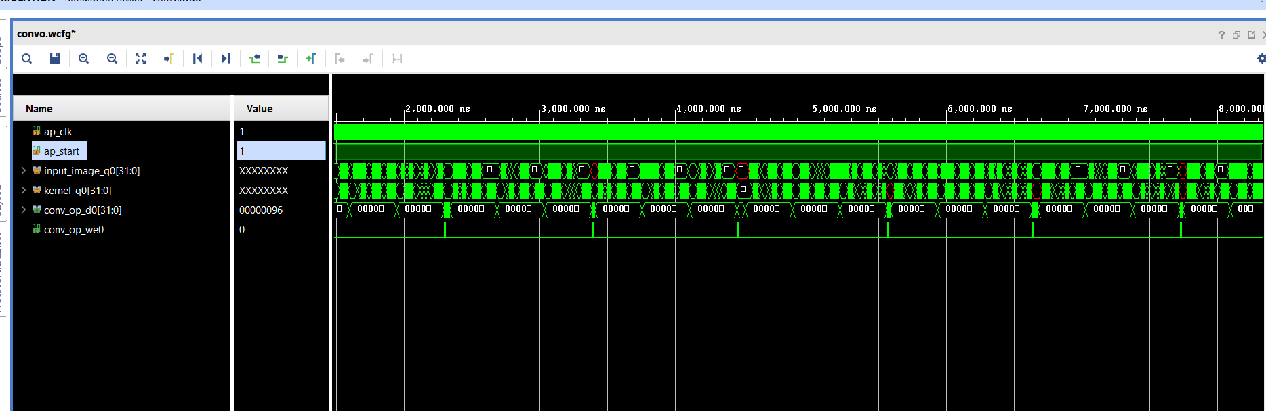
Simulation results (RGB Input images and kernel channels)

Slide 71
Hardware:
Padding Layer

Slide 72
Padding Layer
Inputs: Input matrix of size NxM
Outputs: Output matrix of size N+2*pad x M+2*pad of the NxM matrix surrounded by zeros

Slide 73
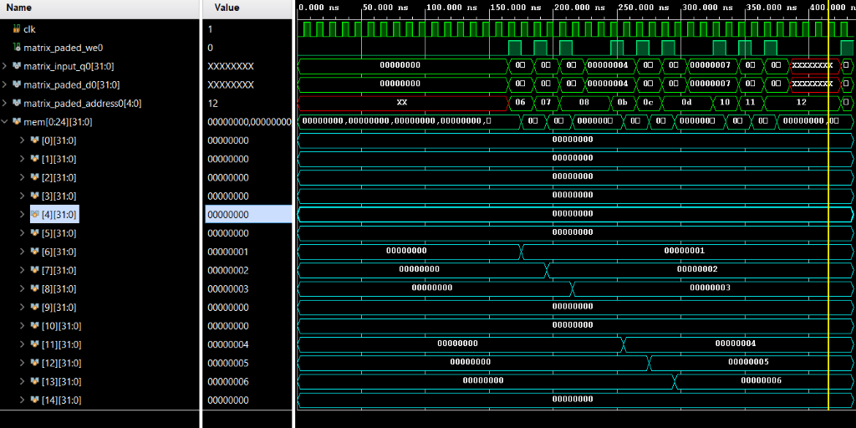
Simulation results

Slide 74
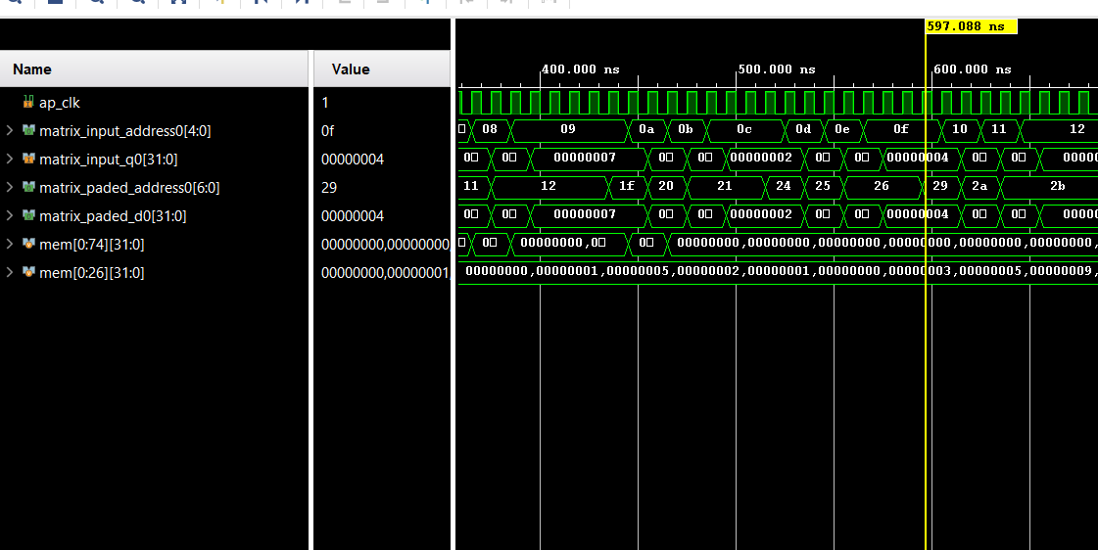
When the input is 3d Matrix (channels * columns*rows)

Slide 75
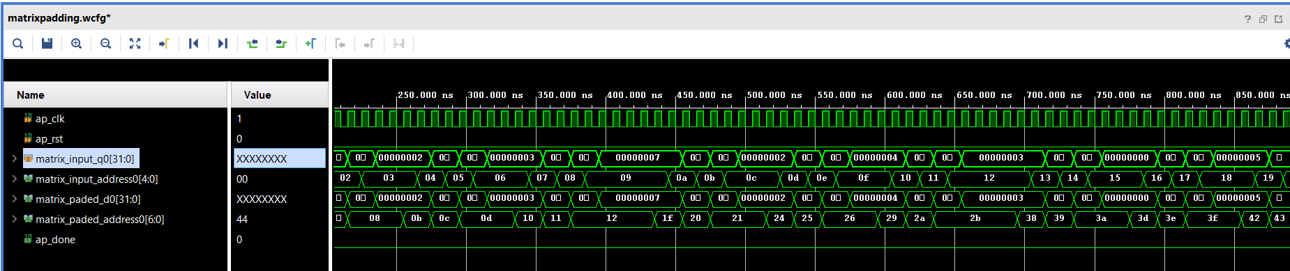
Padding ( padding image with multiple channels )

Slide 76
Hardware:
Max pooling Layer

Slide 77
Max Pooling Layer
Inputs: Input matrix of NxM
Outputs: Output matrix of N/2 x M/2 but with the maximum numbers only of the input

Slide 78
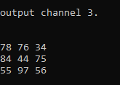
Software Results
Input channel 1
44 | 98 | 69 | 77 | 9 | 51
79 | 60 | 47 | 39 | 70 | 74
99 | 81 | 3 | 54 | 67 | 28
2 | 38 | 72 | 46 | 91 | 45
41 | 23 | 8 | 74 | 18 | 79
23 | 92 | 96 | 62 | 14 | 62
Input channel 3
78 | 16 | 22 | 76 | 34 | 21
73 | 38 | 18 | 50 | 19 | 22
84 | 46 | 39 | 23 | 6 | 41
8 | 38 | 44 | 5 | 66 | 75
0 | 19 | 58 | 38 | 56 | 19
55 | 38 | 49 | 97 | 18 | 8
Input channel 2
75 | 50 | 60 | 57 | 14 | 22
5 | 78 | 18 | 9 | 30 | 78
77 | 29 | 54 | 78 | 52 | 77
92 | 43 | 23 | 89 | 91 | 70
32 | 52 | 54 | 81 | 11 | 14
87 | 9 | 48 | 95 | 55 | 0

Slide 79
Output channel 1
98 | 77 | 74
99 | 72 | 91
92 | 96 | 79
Output channel 2
75 | 60 | 78
92 | 89 | 91
87 | 95 | 55
Output channel 3
78 | 76 | 34
84 | 44 | 75
55 | 97 | 56

Slide 80
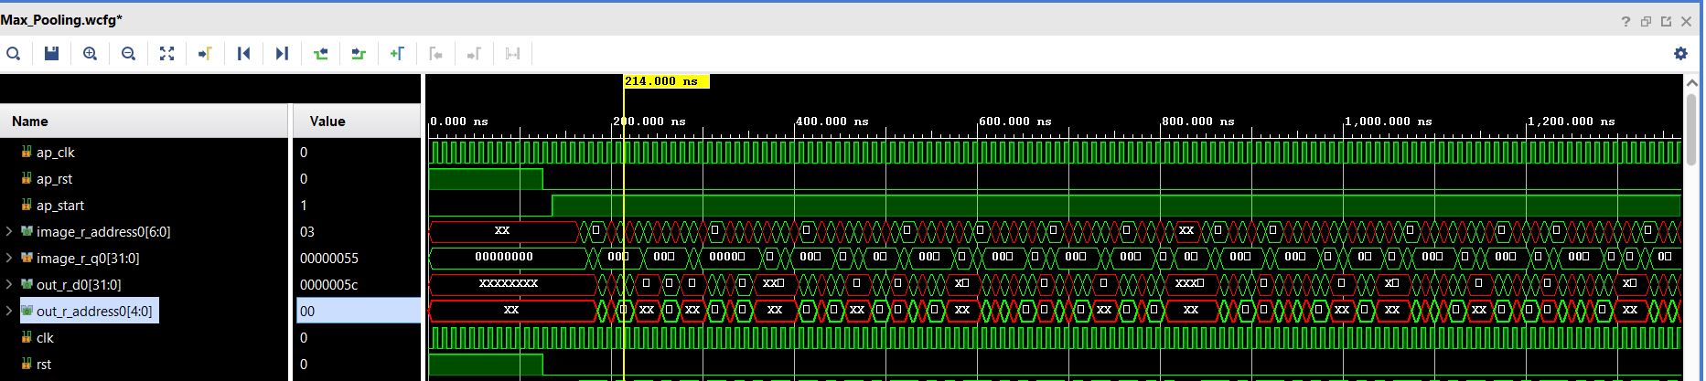
Simulation Results

Slide 81
Hardware:
Softmax

Slide 82
SoftMax
Inputs: 1-dimensional vector.
Outputs: 1-dimensional output vector form which the maximum value is extracted for classification.

Slide 83
Software results
inputs
1.5543212
2.3982123
1.2140216
2.2391090
4.3501839
5.1019327
outputs
0.0175048
0.0407055
0.0124556
0.0347181
0.286671
0.607945
Maximum
value

Slide 84
Hardware:
ReLU

Slide 85
ReLU Layer
Inputs: Input matrix of defined size
Outputs: Output matrix of same defined size but output greater than zero only

Slide 86
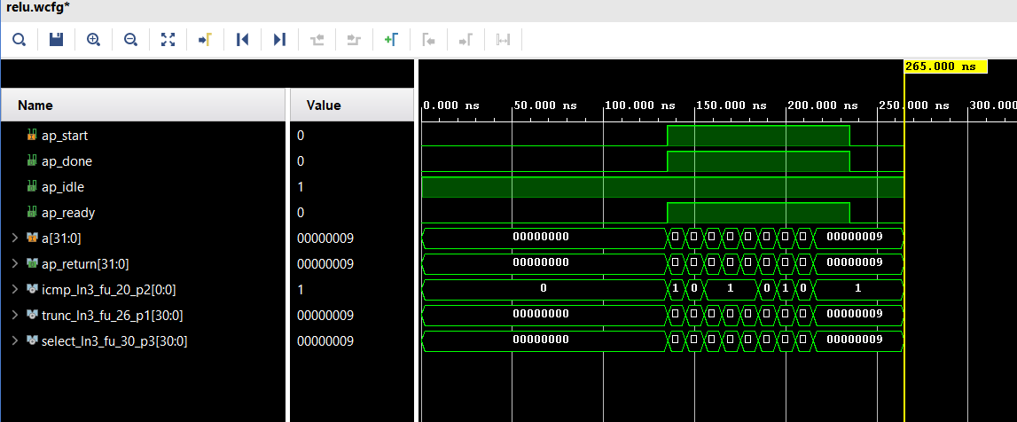
Simulation Results

Slide 87
Hardware:
Fully-connected layer

Slide 88
Fully-Connected Layer
Inputs: Flattened input 1 dimensional
Outputs: The flattened input multiplied by the weights then adding the bias on them

Slide 89
Software Results
Input
1 | 2 | 3 | 4 | 5 | 6 | 7 | 8
Weights (2D array) | 1 | 1
 | 2 | 2
 | 3 | 3
 | 4 | 4
 | 5 | 5
 | 6 | 6
 | 7 | 7
 | 8 | 8
Fully-Connected
Layer
Output
37 | 74 | 111 | 148 | 185 | 222 | 259 | 296
Bias
1 | 2 | 3 | 4 | 5 | 6 | 7 | 8

Slide 90
Performance evaluation
 | Latency(cycles) |  | Latency(absolute)
 | min | max | min | min
Convolution | 869 | 869 | 8.690 us | 8.690 us
padding | 79 | 79 | 0.790 us | 0.790 us
Max pooling | 206 | 206 | 206 | 206
ReLU | 0 | 0 | 0 | 0

Slide 91
Performance evaluation
 | Total |  |  |  |  | Utilization(%)
 | BRAM_18K | DSP48E | FF | LUT | URAM | BRAM_18K | DSP48E | FF | LUT | URAM
Convolution | 0 | 3 | 476 | 757 | 0 | 0 | 0 | 0 | 0 | 0
Padding | 0 | 0 | 59 | 277 | 0 | 0 | 0 | 0 | 0 | 0
Max pooling | 0 | 0 | 471 | 1541 | 0 | 0 | 0 | 0 | 0 | 0
ReLU | 0 | 0 | 0 | 49 | 0 | 0 | 0 | 0 | 0 | 0
Integration of padding& convolution& max pooling | 1 | 3 | 944 | 2186 | 0 | 0 | 0 | 0 | 0 | 0

Slide 92
Future work

Slide 93
Future work
Run Co-Simulation between the hardware and software part
Download the code on FPGA
Construct the whole Faster-RCNN in hardware

Slide 94
Thank You

